Slide 1
CSE 3302
Programming Languages
Kelly Scott French
Spring 2021
Lecture 1 - Introduction,
CSE3302 Programming Languages, UT-Arlington based on slides by Chengkai Li

Slide 2
Self Introduction
Kelly Scott French
Background:
Languages – too many to list,
Worked in industry for 25+ years,
OS/2, DOS, UNIX, Windows, Linux, Arduino,
Teaching CSE3302 for 3 years
Currently a PhD student
My wife teaches CompSci here at UTA
Memberships:
  Tau Beta Pi
  Upsilon Pi Epsilon
Lecture 1 - Introduction,
CSE3302 Programming Languages, UT-Arlington based on slides by Chengkai Li

Slide 3
Basics
Instructor: Kelly French
Office hours: TuTh 2:00 – 3:30pm or by appointment, ERB 339
Contact: kelly.french [at]uta.edu
Assistant Instructor/TA: TBA
Textbook: Kenneth C. Louden & Kenneth A. Lambert, Programming Languages: Principles and Practice, Course Technology, Cengage Learning, 2012.
Reference book: JavaScript: The Good Parts, by Douglas Crockford.
Lecture 1 - Introduction,
CSE3302 Programming Languages, UT-Arlington based on slides by Chengkai Li
<number><number><number>

Slide 4
Basics
Lectures
  Mon/Wed, 2:30pm – 3:50pm NH 106 (section 001)
  Mon/Wed, 4:00pm – 5:20pm SH 100 (section 003)
Slides don’t cover everything – see attendence
The book and supplementary materials are there in case you need more detail and to support the lecture material.
Lecture 1 - Introduction, Spring 2017
CSE3302 Programming Languages, UT-Arlington based on slides by Chengkai Li

Slide 5
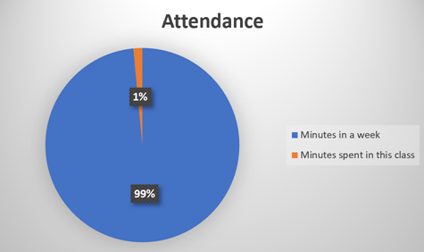
Attendence
Lecture 1 - Introduction
CSE3302 Programming Languages, UT-Arlington based on slides by Chengkai Li

Slide 6
Basics (cont.)
Prerequisites
  Background:
CSE 1325: O-O Programming
CSE 2320: Algorithms & Data Structures
CSE 2312: Comp. Org. & Assembly Lang. Prog.
Automata, grammar, regular expression, …
  Programming:
Experiences with at least one major programming language, you should have used C / C++ / Java in previous courses
Lecture 1 - Introduction,
CSE3302 Programming Languages, UT-Arlington based on slides by Chengkai Li

Slide 7
Tentative grading scheme
Homework: 10%.
Labs: 15%.
4 quizzes: 15% each
Final exam: 15%
NOTE: Please review the Finals schedule to make sure you don’t have a conflict. Yes it happens, rarely, but I’d rather find out early in the semester instead of 3 days before.
Lecture 1 - Introduction,
CSE3302 Programming Languages, UT-Arlington based on slides by Chengkai Li

Slide 8
Homework (HW) 15%
HW1-7
Typically Video-based
Quickly cover broad foundation
Review the materials learned
Get you prepared for the exams
Lecture 1 - Introduction,
CSE3302 Programming Languages, UT-Arlington based on slides by Chengkai Li

Slide 9
Machine Problems (Labs) 15%
4-5 Labs.
Can discuss, but must do it independently.
Decent amount of programming:
  Not crazy
  But not a piece of cake either
Lecture 1 - Introduction,
CSE3302 Programming Languages, UT-Arlington based on slides by Chengkai Li

Slide 10
Deadlines
Degree of lateness Penalty
Each day 10 pts
After 10 days assignments will not be accepted
(No exception, unless you have medical or other emergency)
Start Early!
Lecture 1 - Introduction,
CSE3302 Programming Languages, UT-Arlington based on slides by Chengkai Li

Slide 11
Canvas
Announcements
Assignment instruction and files
Student assignment submission (we don’t accept email submission or hard-copy)
Discussion Group
Grades
Lecture 1 - Introduction,
CSE3302 Programming Languages, UT-Arlington based on slides by Chengkai Li

Slide 12
Exams
Quizzes: 4 each worth 15%
Review class period before, if time allows
Exams are in Canvas, outside of class hours and will use the Lockdown Browser with Monitor
Final: 15%
Review during last schedule class
Time: See university schedule
in Canvas, will use the Lockdown Browser with Monitor
Lecture 1 - Introduction,
CSE3302 Programming Languages, UT-Arlington based on slides by Chengkai Li

Slide 13
Regrade
7 days after we post scores on Canvas and send out announcements. TA will handle regrade requests. Won’t consider it after 7 days.
If not satisfied with the results, 7 days to request again. Instructor will handle it, and the decision is final.
Lecture 1 - Introduction,
CSE3302 Programming Languages, UT-Arlington based on slides by Chengkai Li

Slide 14
How to get [OPTIONAL] bonus points?
During lectures:
  Raise questions. (There are no bad questions.)
  Actively participate in discussions.
  But don’t overdo it please.
In labs
  Organization
  Clarity
  Test Cases
Extra credit project (if there is enough interest)
  The goal is for you to be THINKING
Lecture 1 - Introduction,
CSE3302 Programming Languages, UT-Arlington based on slides by Chengkai Li

Slide 15
Get questions after class?
Discuss with classmates:
  The best way to learn is to teach.
  No sharing of code
  General questions (that can be asked by any student):
  Post on discussion group (Canvas, Piazza, or Google group)
Individual questions (that apply to you specifically):
  Email TA
  No need to CC me. If TA cannot handle it, they will forward to me.
Come to TA’s office hours or my office hours using Teams.
Lecture 1 - Introduction,
CSE3302 Programming Languages, UT-Arlington based on slides by Chengkai Li

Slide 16
Get bored
Do you watch Youtube?
Lecture 1 - Introduction,
CSE3302 Programming Languages, UT-Arlington based on slides by Chengkai Li

Slide 17
http://www.youtube.com/watch?v=gC2ew6qLa8U
Don’t do it. It’s not worth it.
Lecture 1 - Introduction,
CSE3302 Programming Languages, UT-Arlington ©Chengkai Li, 2008

Slide 18
CSE 3302: What is it about?
Exposure to various kinds of languages and paradigms.
Understand the features, pros/cons of languages.
Understand the problems facing compilers.
Learn a new language effectively and quickly.
Choose a language to use for a project/system.
Design new languages.
Lecture 1 - Introduction,
CSE3302 Programming Languages, UT-Arlington based on slides by Chengkai Li

Slide 19
CSE 3302: What isn’t it about?
I want to get easy credit without doing much.
I want to become a coding guru in C/C++/C#/Java/…
I want to know every details about implementing a language.
I want to prove properties of a language.
Lecture 1 - Introduction,
CSE3302 Programming Languages, UT-Arlington based on slides by Chengkai Li

Slide 20
Schedule
Turing Machines
The Halting Problem
Language Design Criteria
Language Paradigms
  Functional
  Logical
  Object Oriented
Syntax
Semantics
Control Structures
  Expressions
  Statements
  Procedures
  Environments
Data Types
Lecture 1 - Introduction, Spring 2017
CSE3302 Programming Languages, UT-Arlington based on slides by Chengkai Li

Slide 21
Homework #1
Optional
Special Interests or topics
Closes next week
Lecture 1 - Introduction, Spring 2017
CSE3302 Programming Languages, UT-Arlington based on slides by Chengkai Li

Slide 22
Language Flexibility
Let’s draw a picture
Lecture 1 - Introduction,
CSE3302 Programming Languages, UT-Arlington based on slides by Chengkai Li

Slide 23
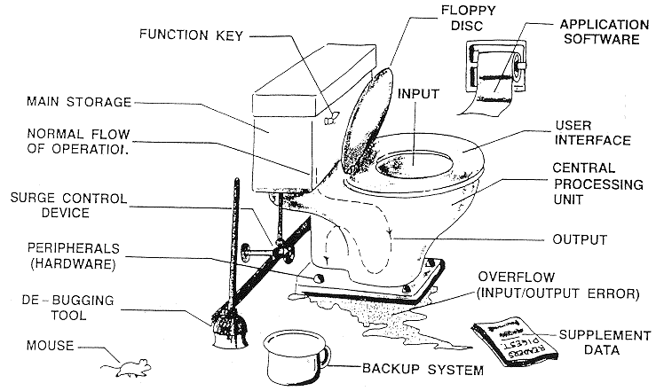
Big picture?
http://thunder.prohosting.com/~ccastle/MyComputer.gif
Lecture 1 - Introduction,
CSE3302 Programming Languages, UT-Arlington based on slides by Chengkai Li

Slide 24
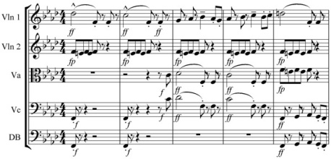
Purpose of Language
Lecture 1 - Introduction,
CSE3302 Programming Languages, UT-Arlington based on slides by Chengkai Li

Slide 25

Purpose of Language
Lecture 1 - Introduction,
CSE3302 Programming Languages, UT-Arlington based on slides by Chengkai Li

Slide 26
Music Notation is a Language?
Communication between composer and performer
Music has both semantics and syntax
Music score is instructions to be executed by one or more performers
Not just *what* note to ply but
*who* - what instrument and which part if multiples
*where* - solo, duet, small group, full orchestra
*how* - soft / loud or how long - staccato / slurred
*when* - measures, rests
*how fast* - tempo, time signature
The bars help distinguish notes in a standard way, the clef sets out the reference point for the bars
Lecture 1 - Introduction,
CSE3302 Programming Languages, UT-Arlington based on slides by Chengkai Li

Slide 27
Truths about Programming Languages
Thousands exist
More created every year
Popular now does not mean popular forever
https://youtu.be/Og847HVwRSI
Lecture 1 - Introduction, Spring 2017
CSE3302 Programming Languages, UT-Arlington based on slides by Chengkai Li

Slide 28
More on Languages
Constructed languages
  Klingon
  Dothraki
  Elvish
  Esperanto
Toy Languages
  Cow (https://esolangs.org/wiki/COW)
Lecture 1 - Introduction, Spring 2017
CSE3302 Programming Languages, UT-Arlington based on slides by Chengkai Li

Slide 29
Transition
Moving to Programming Languages
Good place to end/begin
Lecture 1 - Introduction, Spring 2017
CSE3302 Programming Languages, UT-Arlington based on slides by Chengkai Li

Slide 30

What is a programming language?
OS
printf("hello, world\n");
CPU
Memory
Programmers use PLs to instruct computers to do things.
Lecture 1 - Introduction,
CSE3302 Programming Languages, UT-Arlington based on slides by Chengkai Li

Slide 31

Programming languages?
LDA #2
STA X
SELECT name
FROM Students
Where status=“sleeping”
(http://encarta.msn.com/media_461557622/ENIAC.html)
We talk about high-level general-purpose programming languages.
Lecture 1 - Introduction,
CSE3302 Programming Languages, UT-Arlington based on slides by Chengkai Li

Slide 32
Machine Readability
printf("hello, world\n");
OS
executable
CPU
compiler
Memory
No ambiguity
Efficient translation/compilation
…
Covered in compiler course
Lecture 1 - Introduction,
CSE3302 Programming Languages, UT-Arlington based on slides by Chengkai Li

Slide 33
Human Readability
printf("hello, world\n");
executable
OS
CPU
compiler
Memory
This is what really matters
  Abstractions for describing the actions
    Data abstraction: subject of computation
    Control abstraction: transfer of control in computation
  Human-Human communications
    Your program will be read by others
Lecture 1 - Introduction,
CSE3302 Programming Languages, UT-Arlington based on slides by Chengkai Li

Slide 34
Paradigms
Imperative/Procedural: (ALGOL, FORTRAN , Pascal, C, Ada)
control statements manipulate the data and program states
OO: (C++, Java, Smalltalk)
data/object-centric
Functional: (Lisp, Scheme, ML, Haskell)
everything is done by function evaluations
Logic: (Prolog)
axioms (statements about truth) + inferences
Parallel: (threads in Java)
Mix: (Python, Perl, Ruby)
Few “pure” languages
Lecture 1 - Introduction,
CSE3302 Programming Languages, UT-Arlington based on slides by Chengkai Li

Slide 35
Syntax and Semantics
Syntax:
structure of programs (tokens, keywords, statements.)
Semantics:
The expected behavior of a given syntactical construct
Lecture 1 - Introduction,
CSE3302 Programming Languages, UT-Arlington based on slides by Chengkai Li

Slide 36
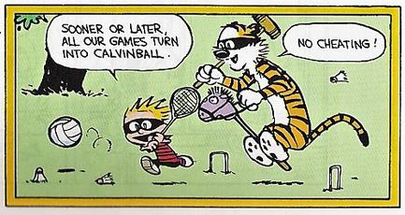
Syntax and Semantics
Can a language exist without syntax?
A language without syntax? Calvin Ball
Lecture 1 - Introduction,
CSE3302 Programming Languages, UT-Arlington based on slides by Chengkai Li

